Slide 1



IIT DELHI
First Alumni Impact Report 2026
Story of 65,000+ alums over 60 years

Slide 2

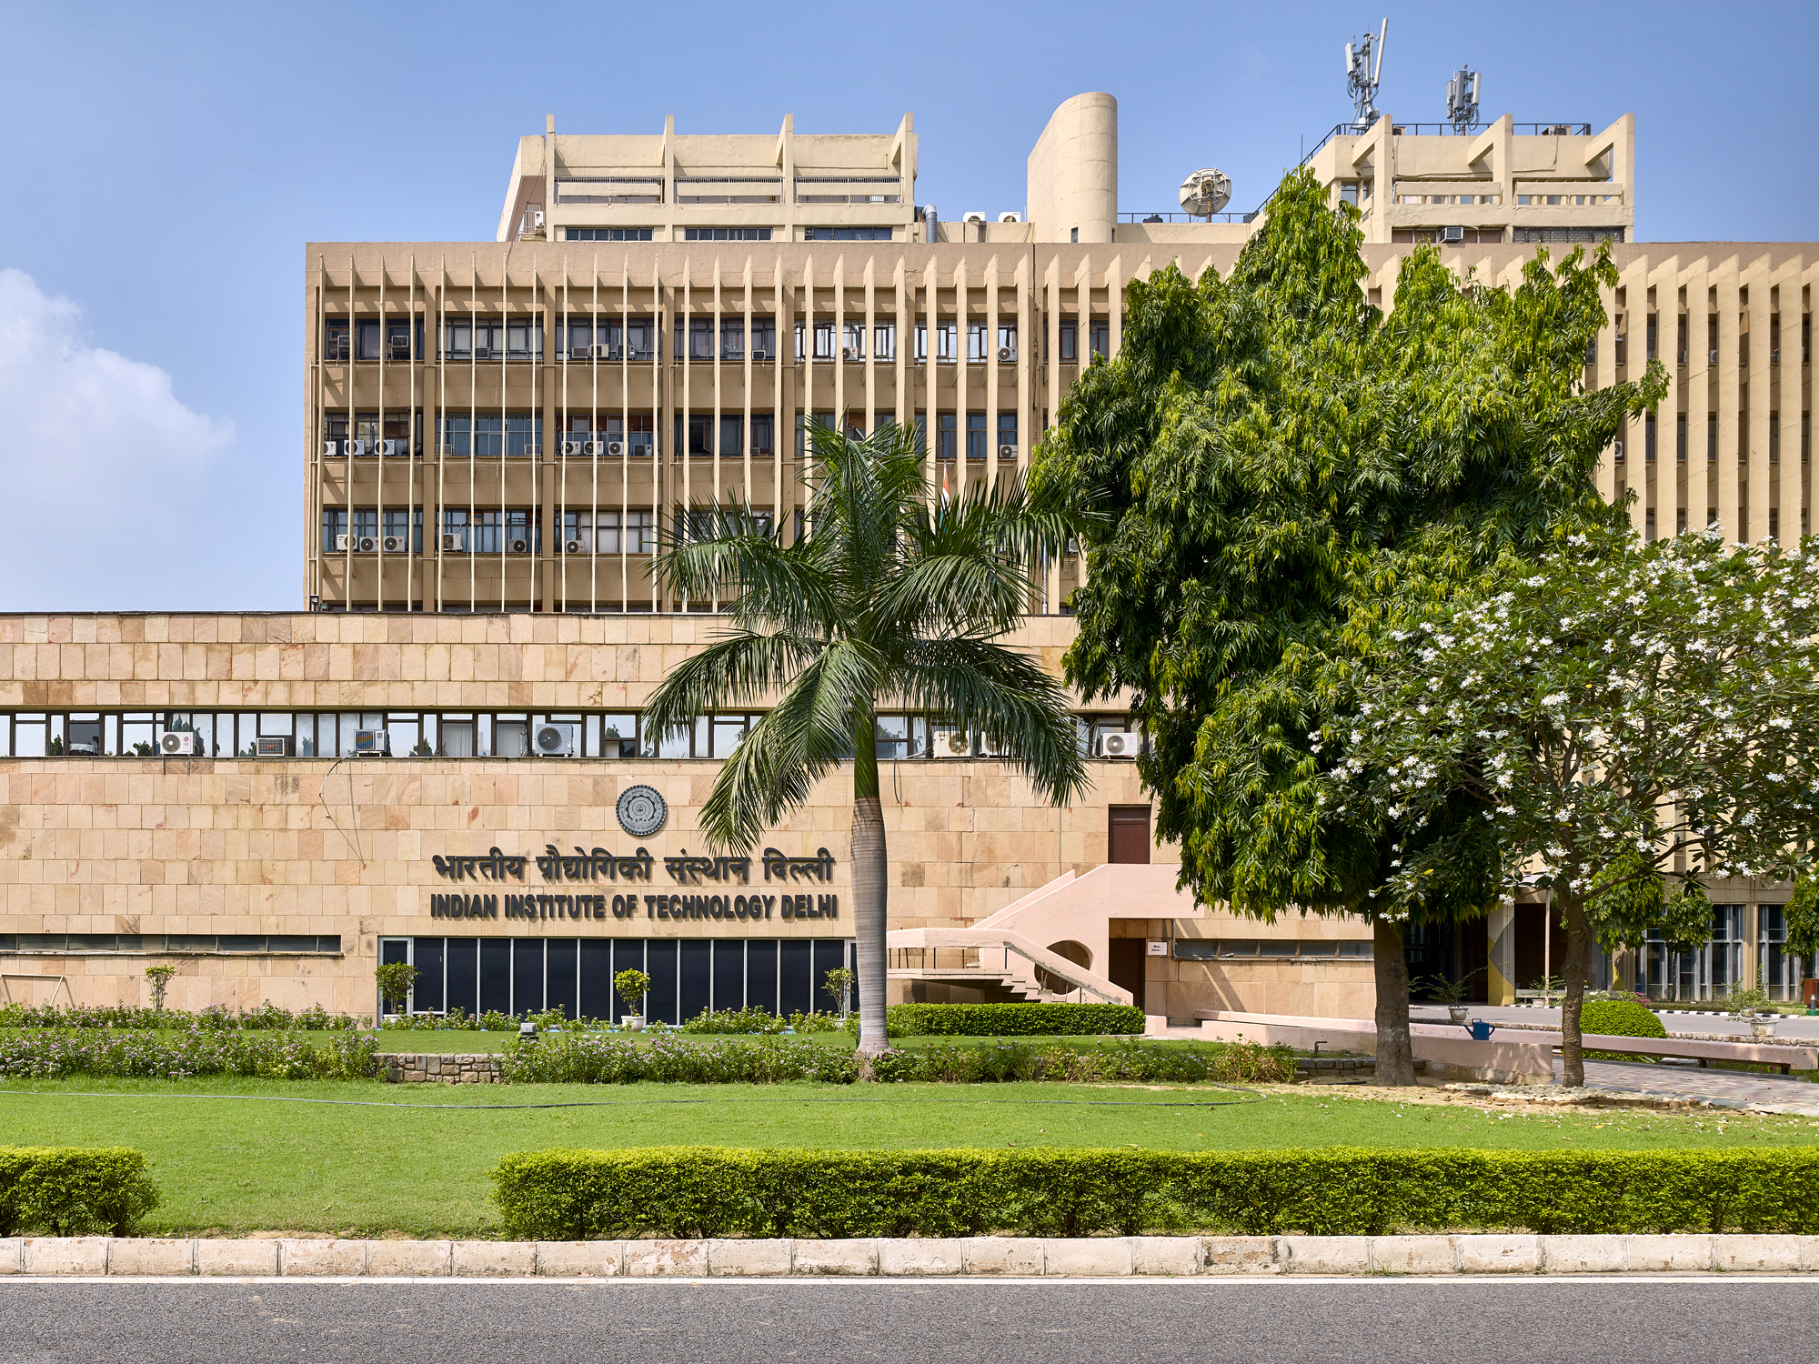
IIT Delhi - A Brief Overview
65000+
No of alums
150
No of alums
18 UG
45+ PG
No of degrees
(B.Tech, M.Tech. Ph.D, MSc, MSR, MBA etc)
04 UG
07 PG
No of degrees
(B.Tech, M.Tech.
Ph.D, MSc,)
06
No of schools
1966
2025
11
No of centres
01
No of centres
16
No of centres of
excellence
06
No of departments
16
No of departments
109
UG
40
PG
01
Ph.D
1054 UG
1709 PG
Degrees Granted
Degrees Granted
incl. Dual degree & Ph.D
1233 UG
2311 PG
Intake 2025
incl. Dual degree & Ph.D
Source: IIT Delhi

Slide 3
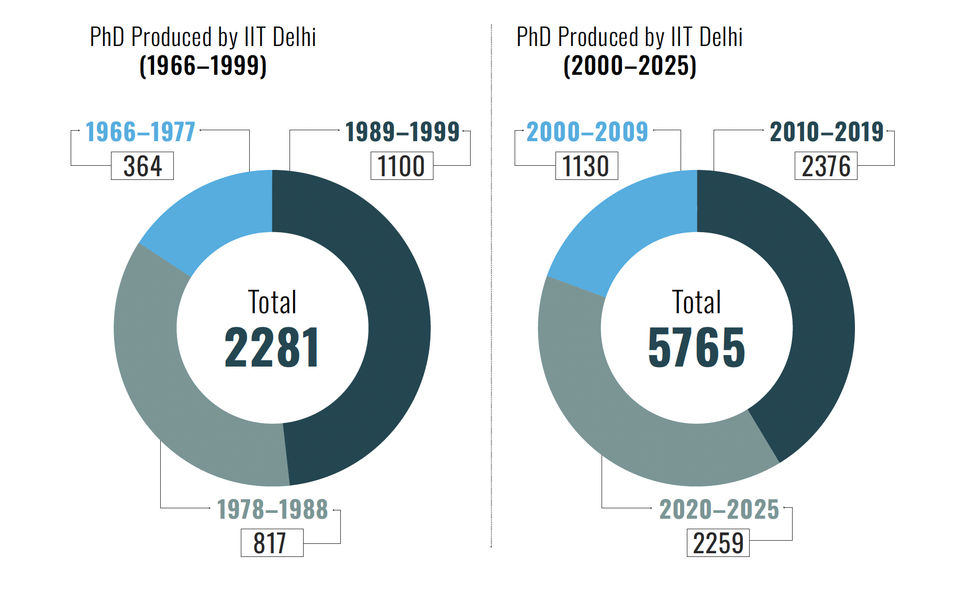

Slide 4
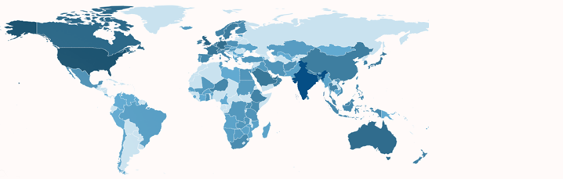








Global map distribution
Country | Alumni
India | 40000+
United States | 7000+
United Kingdom | 1000+
United Arab Emirates | 800+
Canada | 800+
Singapore | 600+
Australia | 500+
Germany | 500+
Netherlands | 200+
France | 200+
Saudi Arabia | 150+
Switzerland | 150+
Japan | 125+
Sweden | 100+
Sectoral distribution
Source: LiveAlumni.com
Public Services & Governance
Corporate Leaders
Entrepreneurship & Startup
Academic & Research
Politics & Public Policy
NGO, Philanthropy & Social Impact
Defence
Cultural Impact

Slide 5
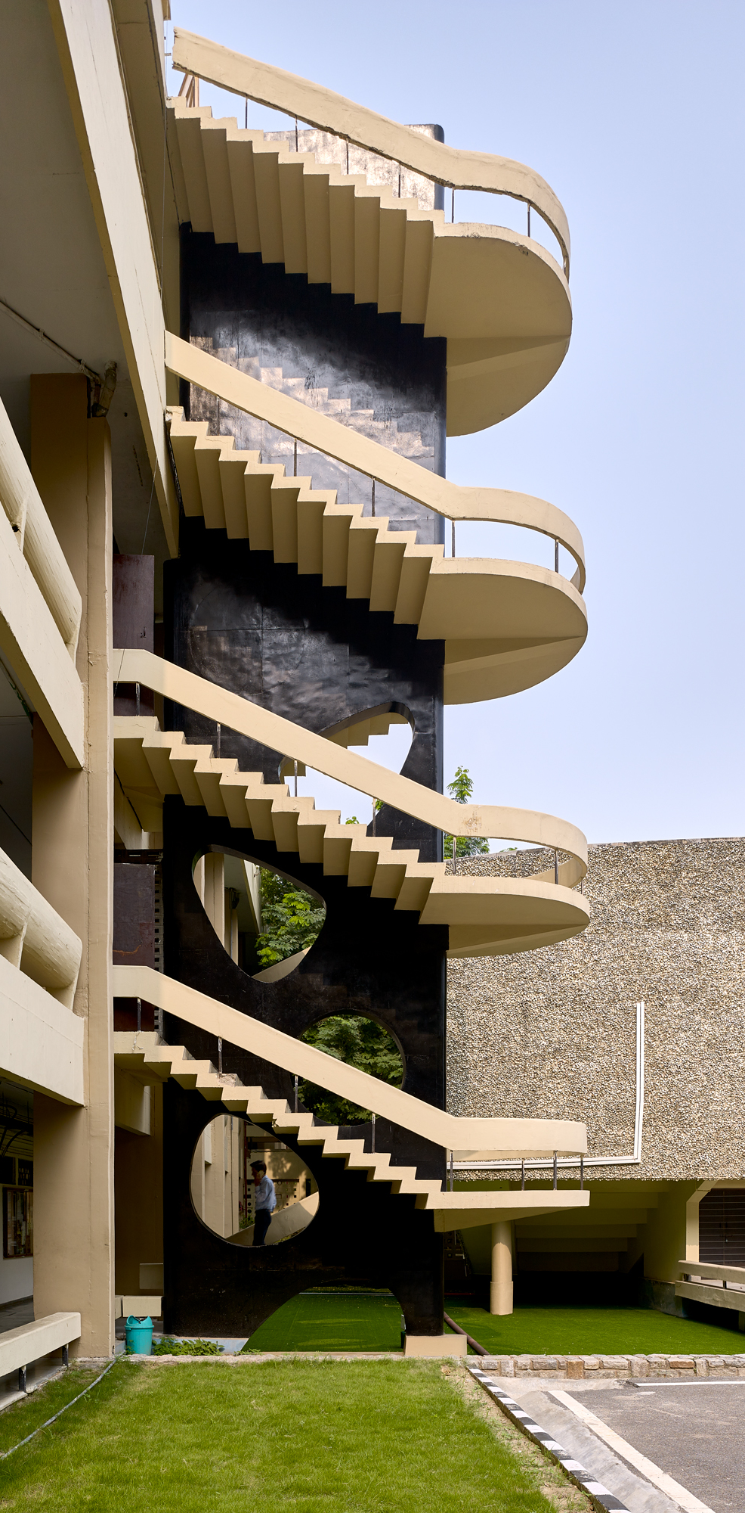
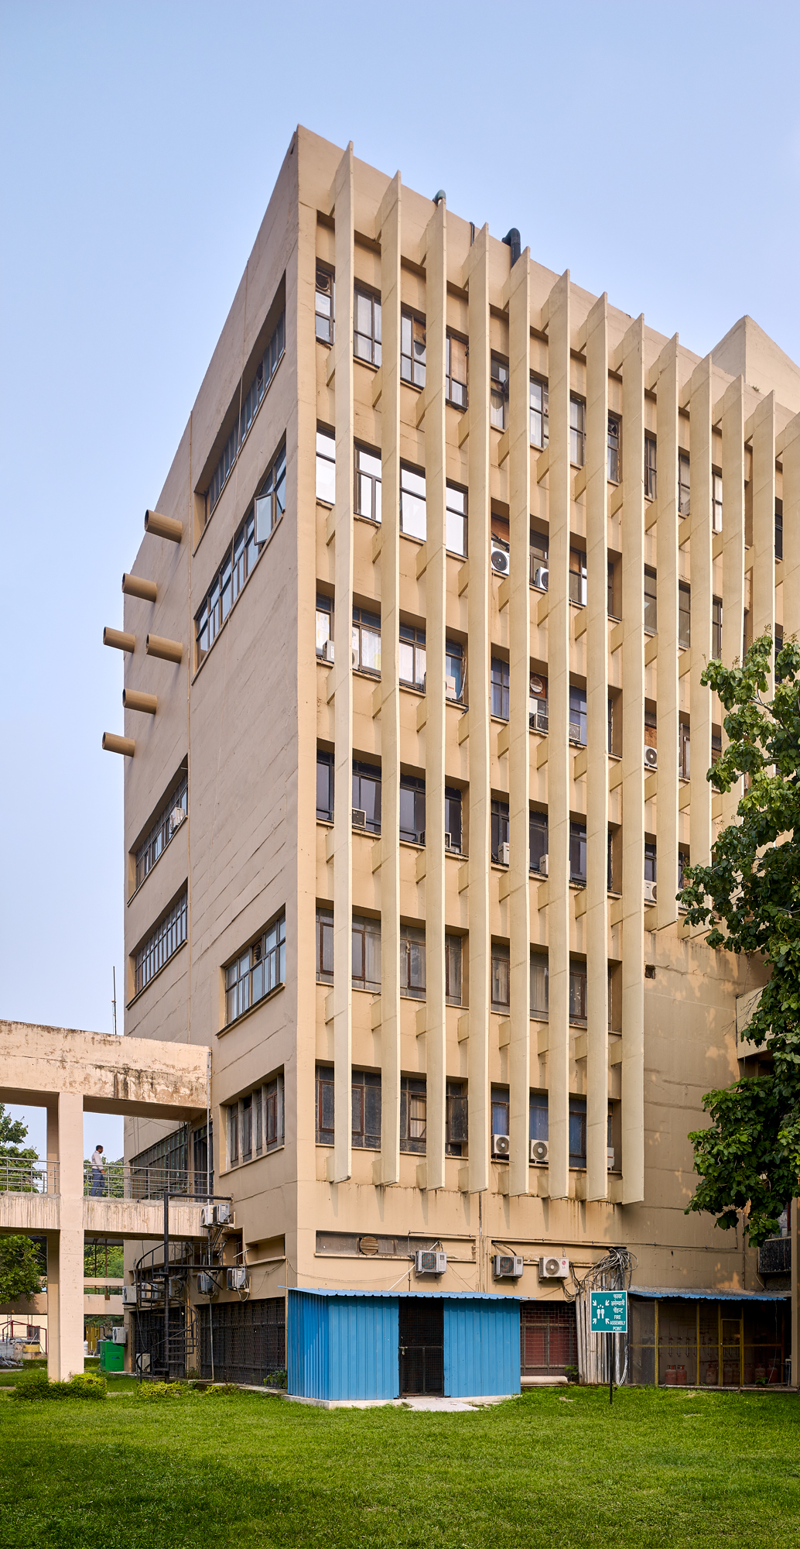
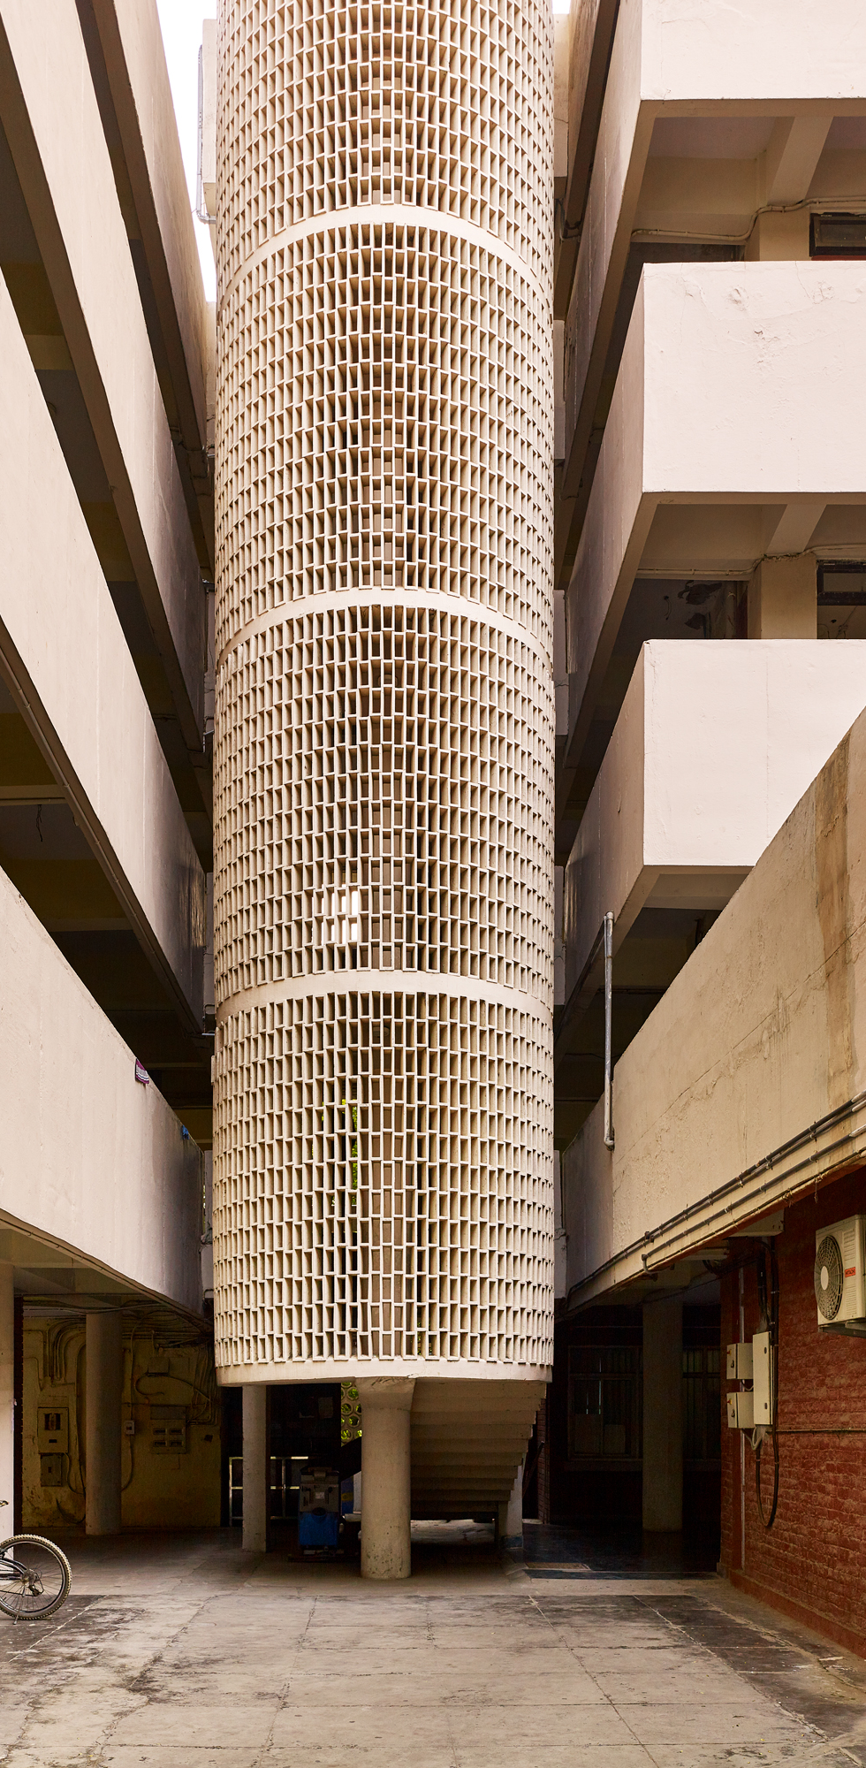
Creating Global Impact
Entrepreneurship
Corporate Leadership
Academia
Civil Services
Global Achievers
2500+ Founders/Co-Founders/Leaders in Start Ups globally
15%
alumni in leadership roles
50+
Alumni as faculty in QS Top 100 Universities
270+
Serving IAS Officers, 100 + serving across IPS, IRS, IFS etc.
6+ Alums
feature in wealth lists (Forbes & Hurun)
Source: IIT Delhi, Traxcn, LiveAlumni.com

Slide 6
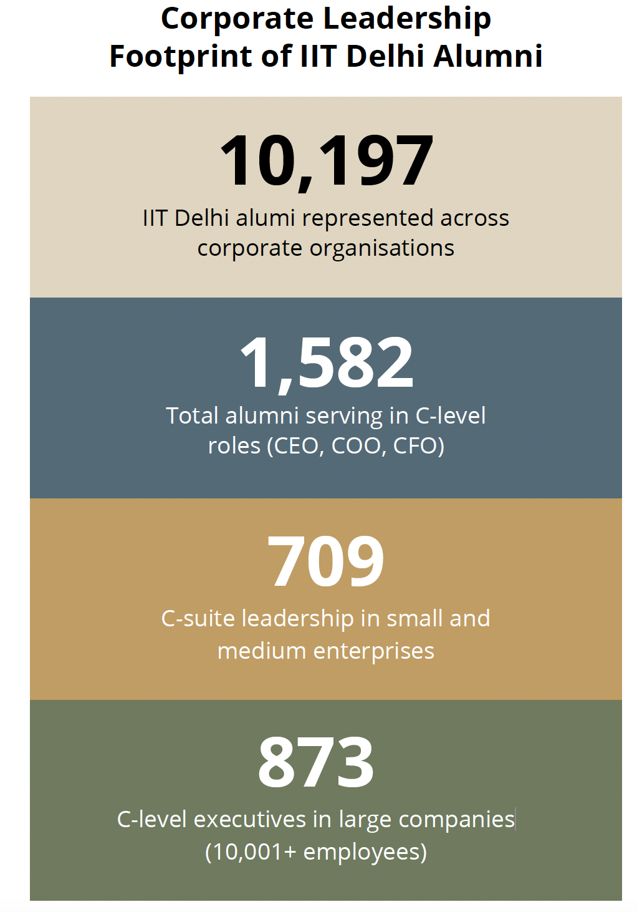
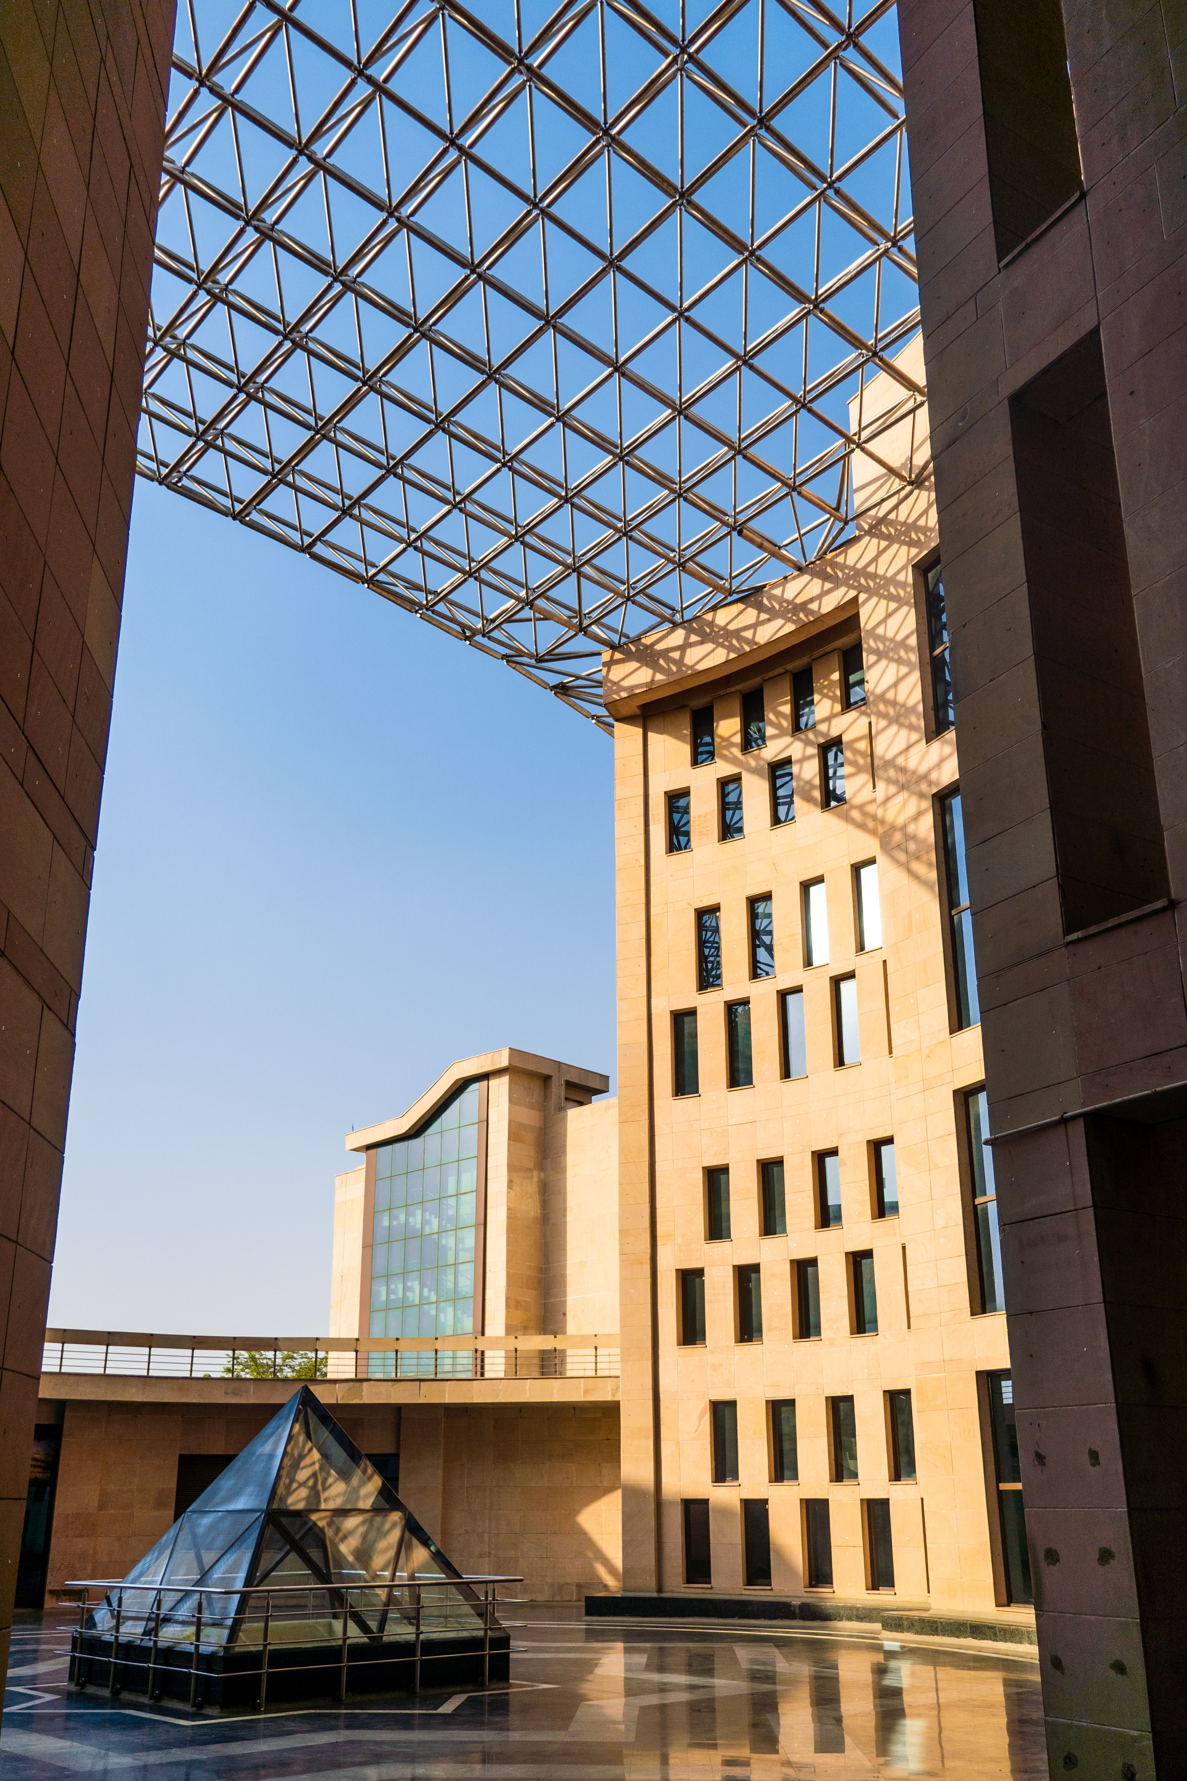
Startups revolution
FINTECH | PayU, Pine Labs, BharatPe, Groww, OfBusiness
IT & IT SERVICES | Rubrik, Harness, Glean, Axtria, Fractal Analytics
EDTECH | upGrad, FIITJEE, Testbook, CENTA, ClassPlus, LeverageEdu
E-COMMERCE | Flipkart, Zomato, Meesho, Udaan, Snapdeal, Blinkit
HEALTH | Tata 1mg, HealthKart, PharmEasy, Practo, Anthem Biosciences

Slide 7
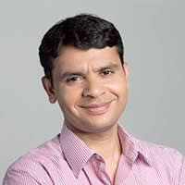
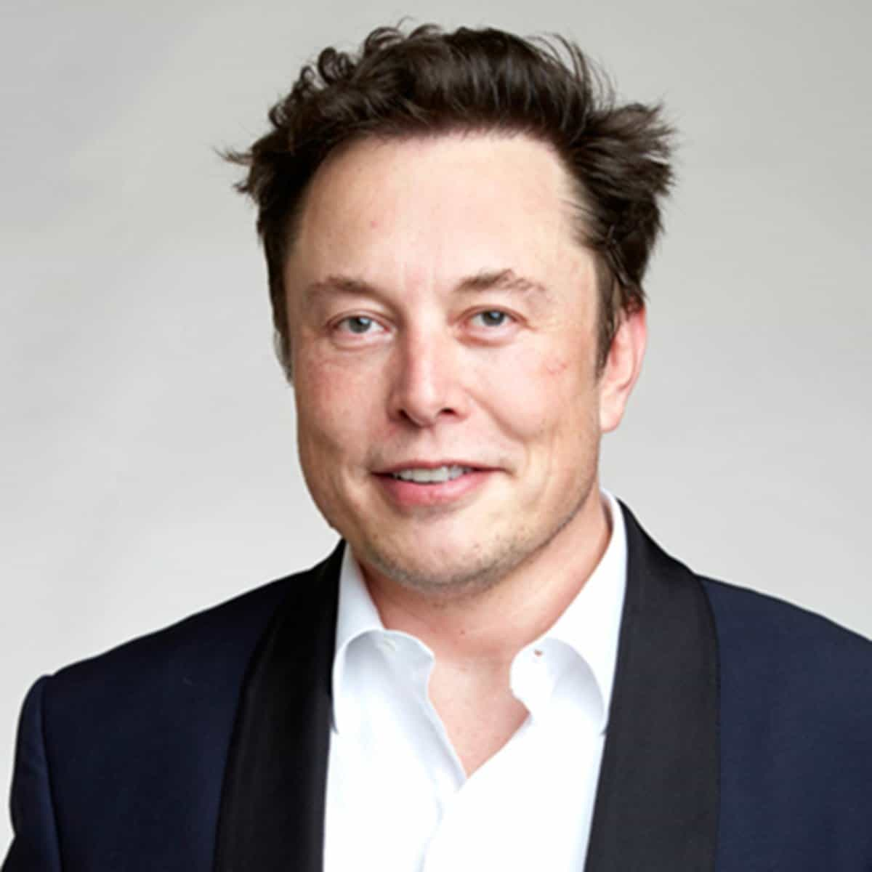
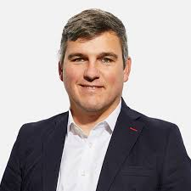
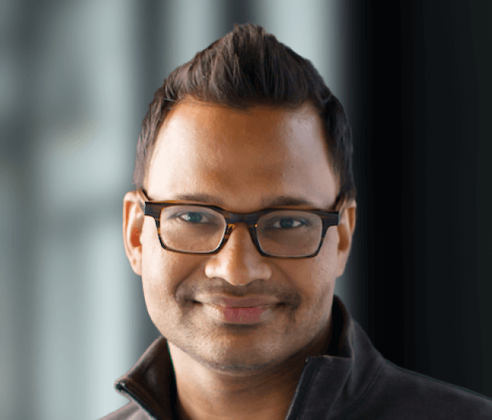
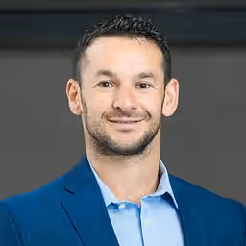
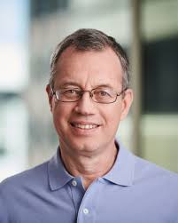
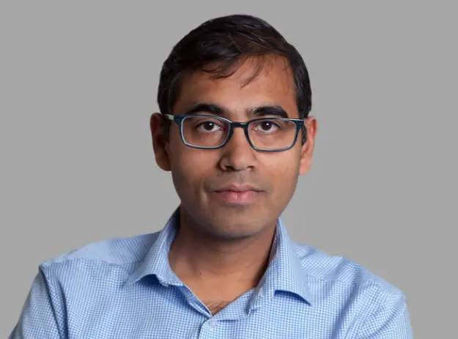
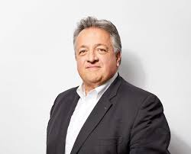
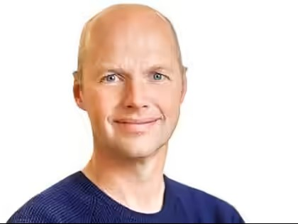
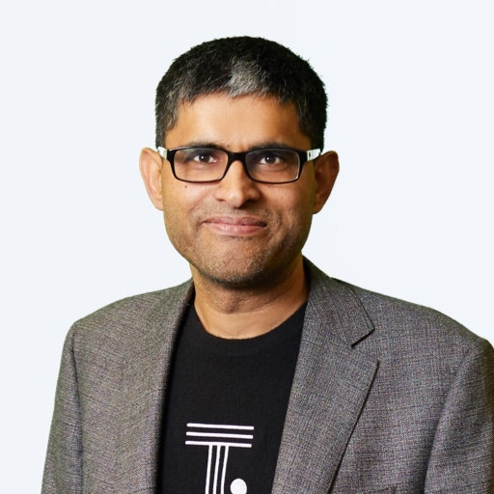
Immigrant founders who founded two or more unicorns
Mohit Aron
P.O.B- India
Unicorns- Nutanix,
Cohesity
Ignacio Martinez
P.O.B- Spain
Unicorns- Indigo Ag, Inari
Elon Musk
P.O.B- South Africa
Unicorns- Tesla, Seace X & the Boring Company
Jyoti Bansal
P.O.B- India
Unicorns- AppDynamics,
Harness
IIT DELHI
Al Goldstein
P.O.B- Uzbekistan
Unicorns- Avant, Amount
Ion Stoica
P.O.B- Romania
Unicorns- Databricks, Anyscale
Ashutosh Garg
P.O.B- India
Unicorns- Bloomreach,
Eightfold.ai
Noubar Afeyan
P.O.B- Lebanon
Unicorns- Moderna, Indigo Ag
Sebastian Thrun
P.O.B- Germany
Unicorns- Cresta, Udacity
Ajeet Singh
P.O.B- India
Unicorns- Nutanix, ThoughtSpot
*P.O.B- Place of Birth
Source: BusinessToday.in & National Foundation for American Policy (NFAP) report

Slide 8
Strengthening the nation decade after decade
250+ Leaders
in India’s PSU’s regulators, scientific institutions & missions
Naval Construction Wing has trained over 700+ Officers for the Indian Navy
Alumni led NGO’s & philanthropic efforts have impacted more than 5 millions lives across education, livelihoods, health, and development
650+ Alumni currently serving across India’s public institutions
Over
300 alumni serving as faculty in other IIT’s
Source: IIT Delhi, Traxcn, LiveAlumni.com, Vidhwaan

Slide 9

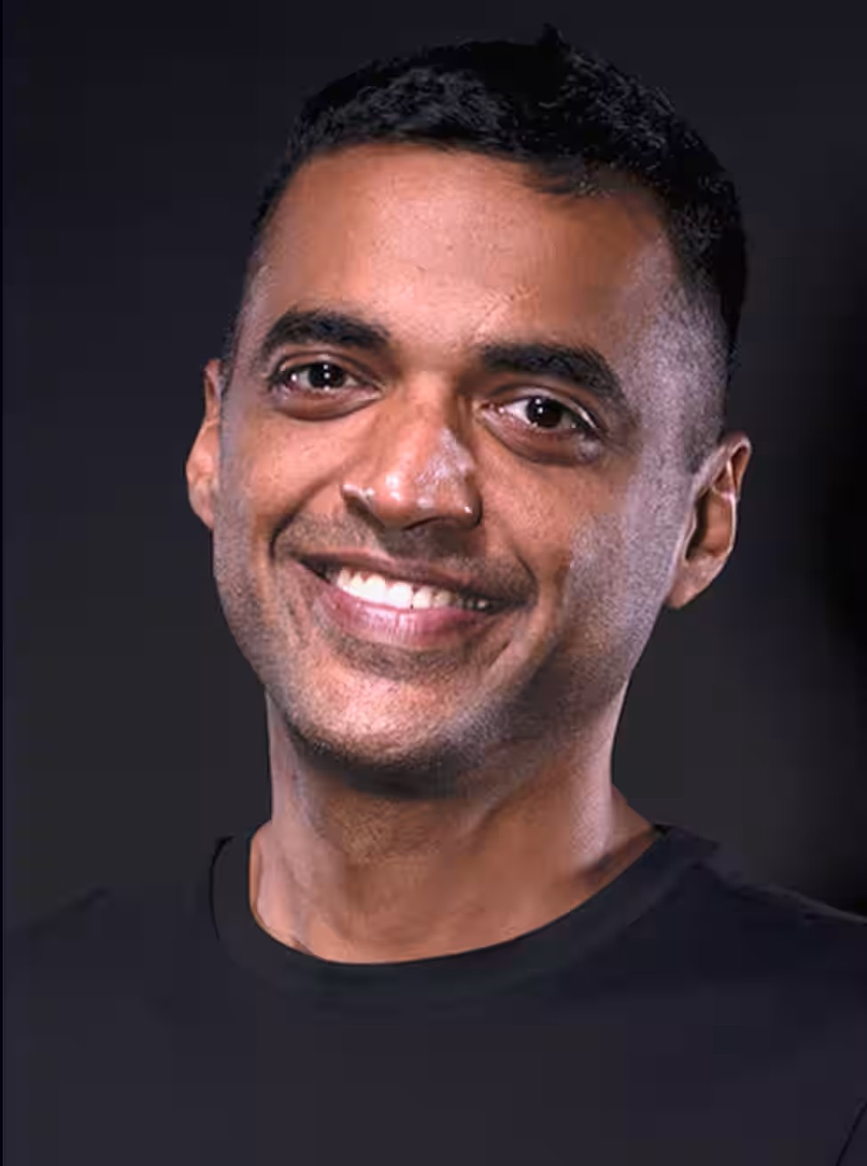
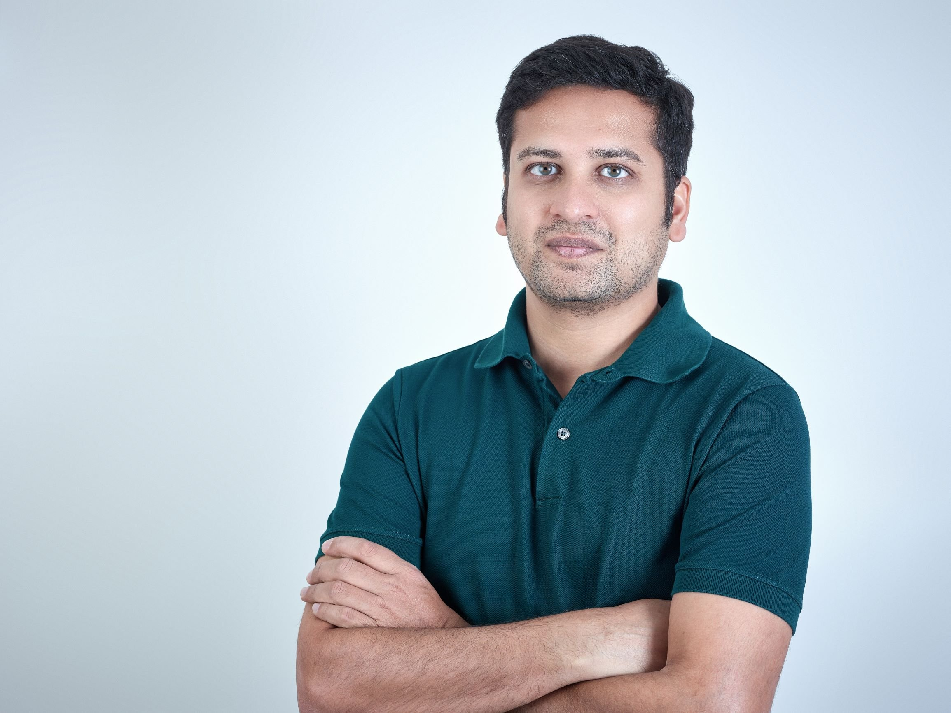
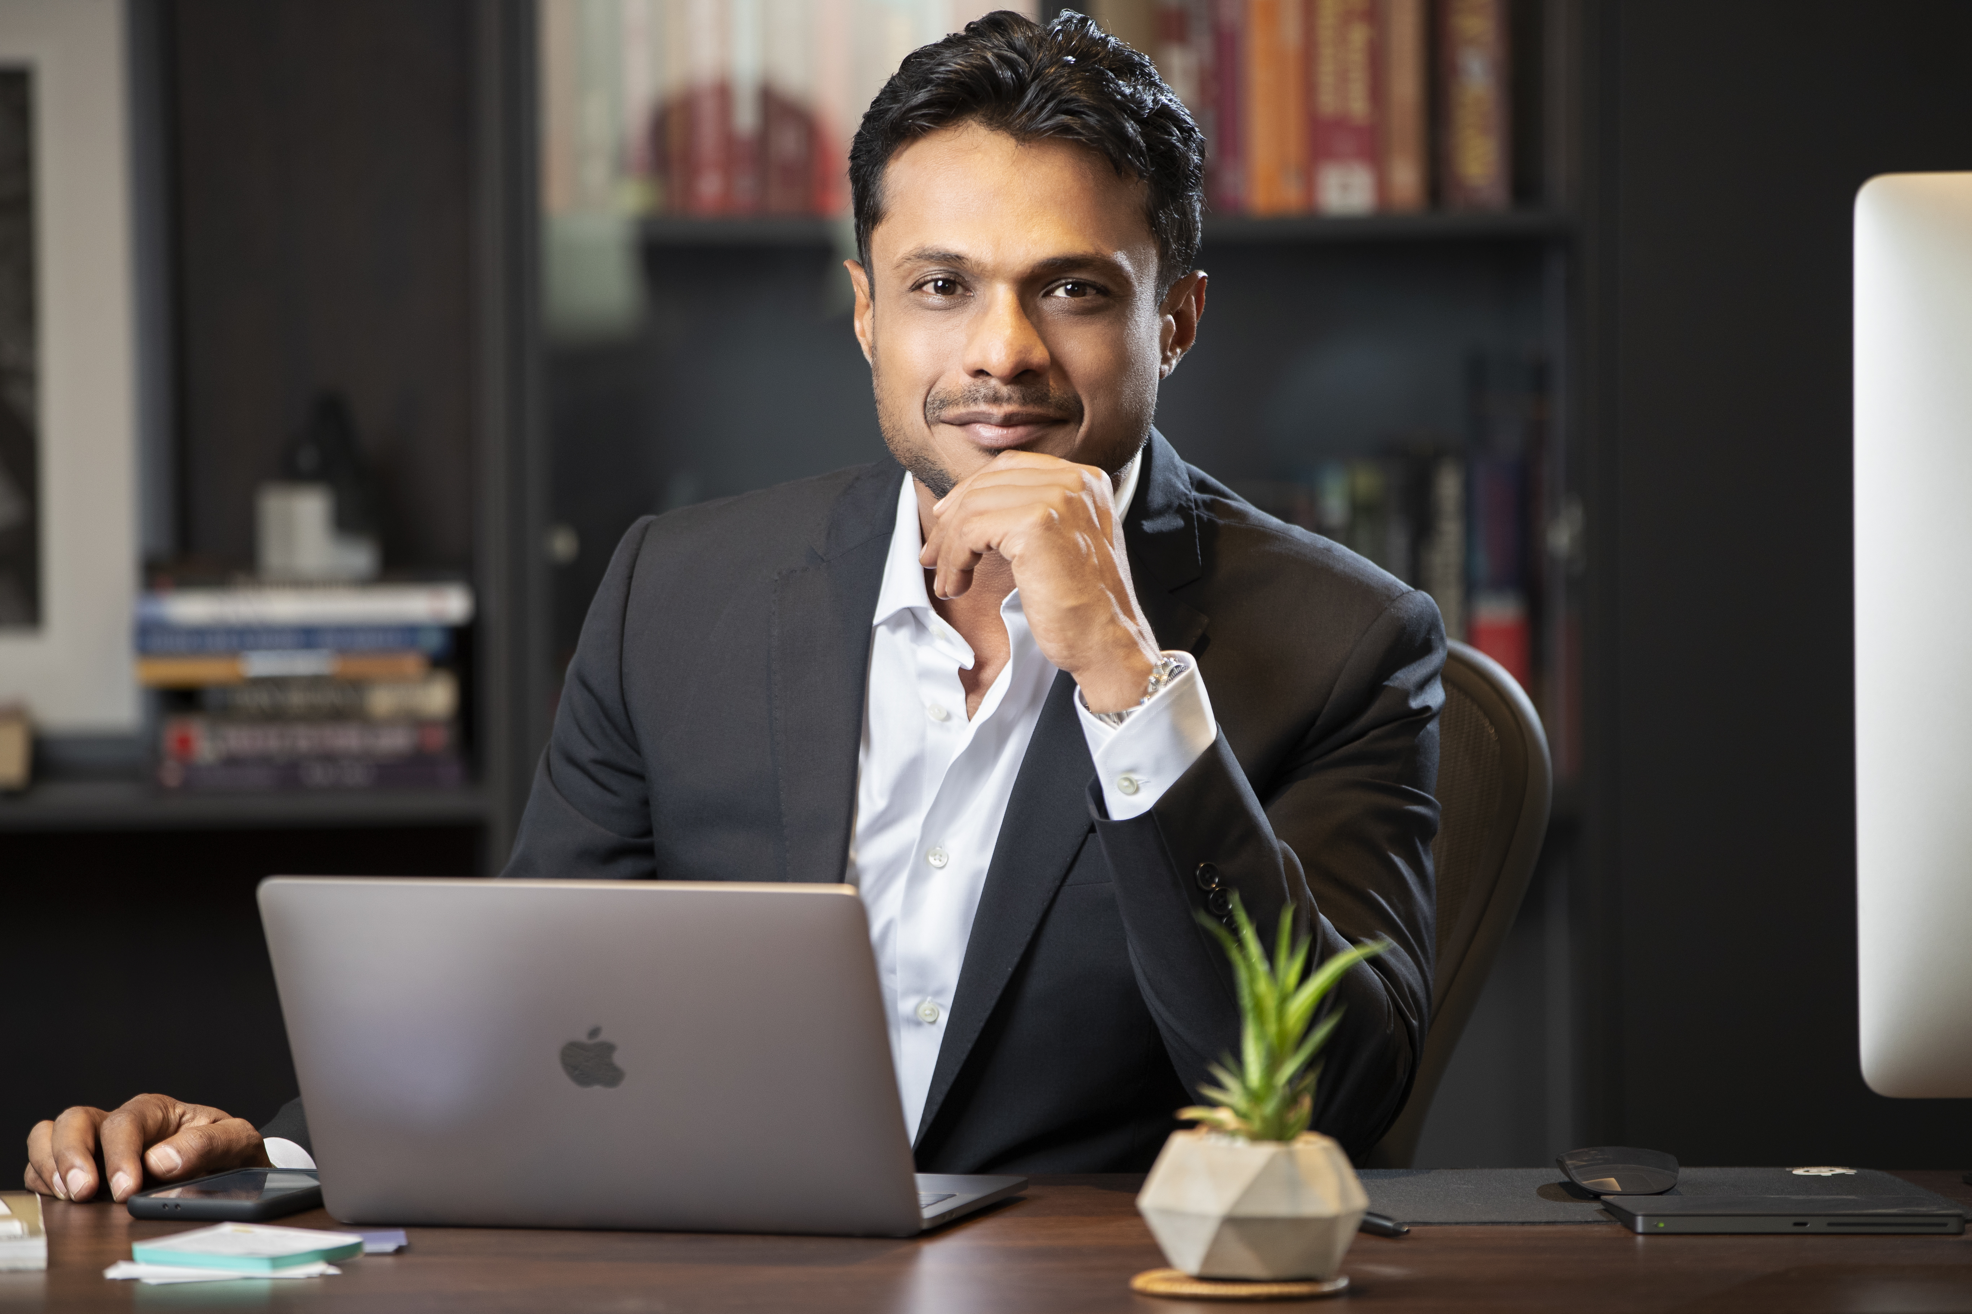
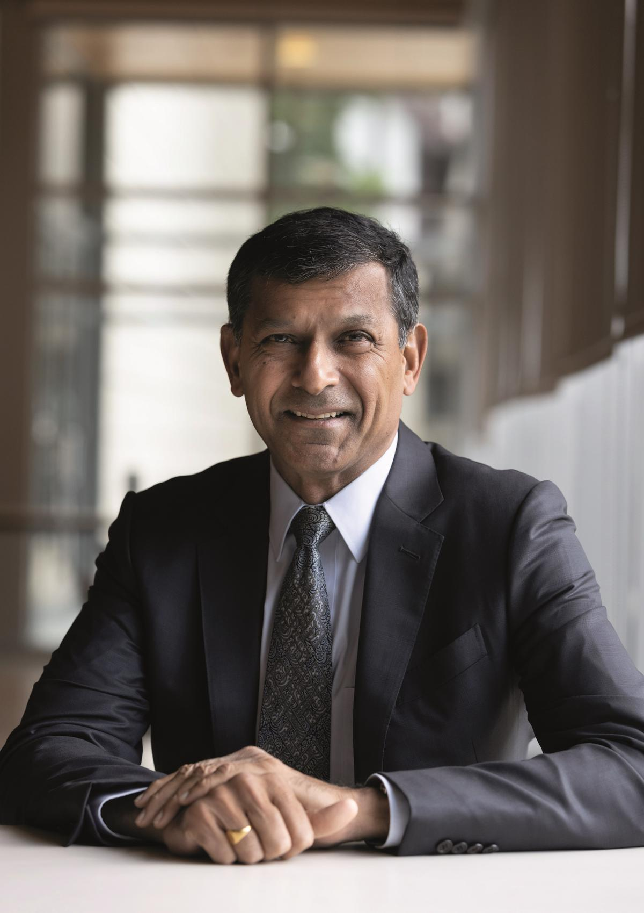
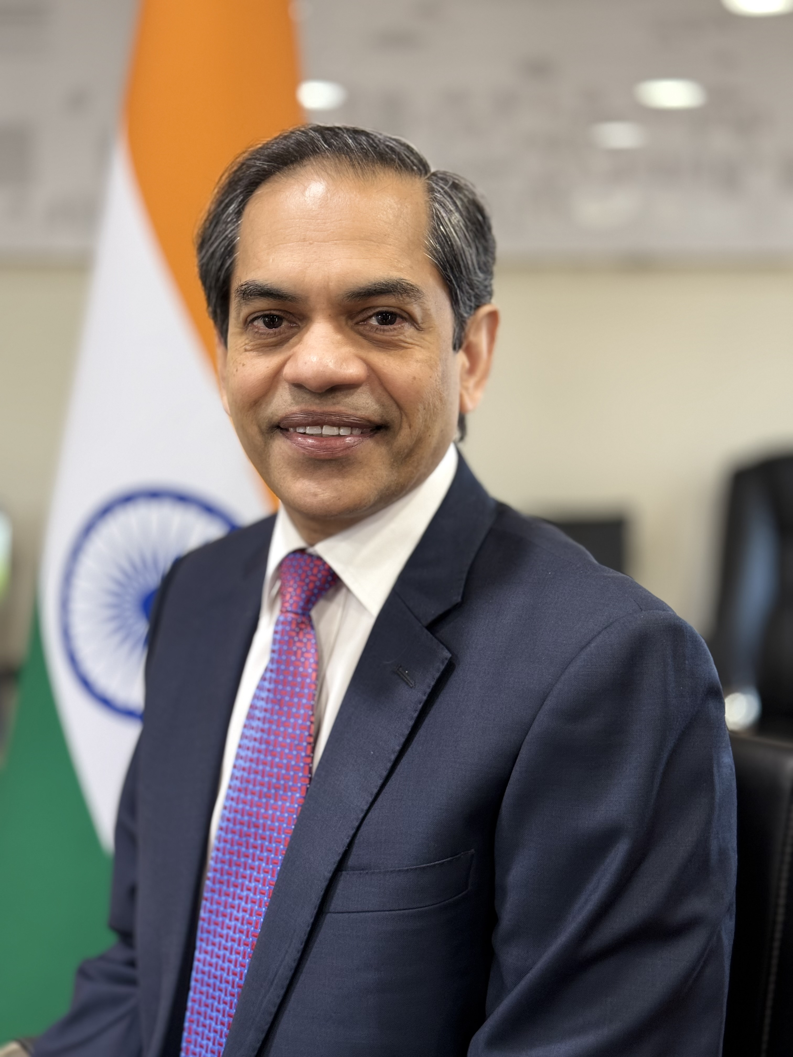
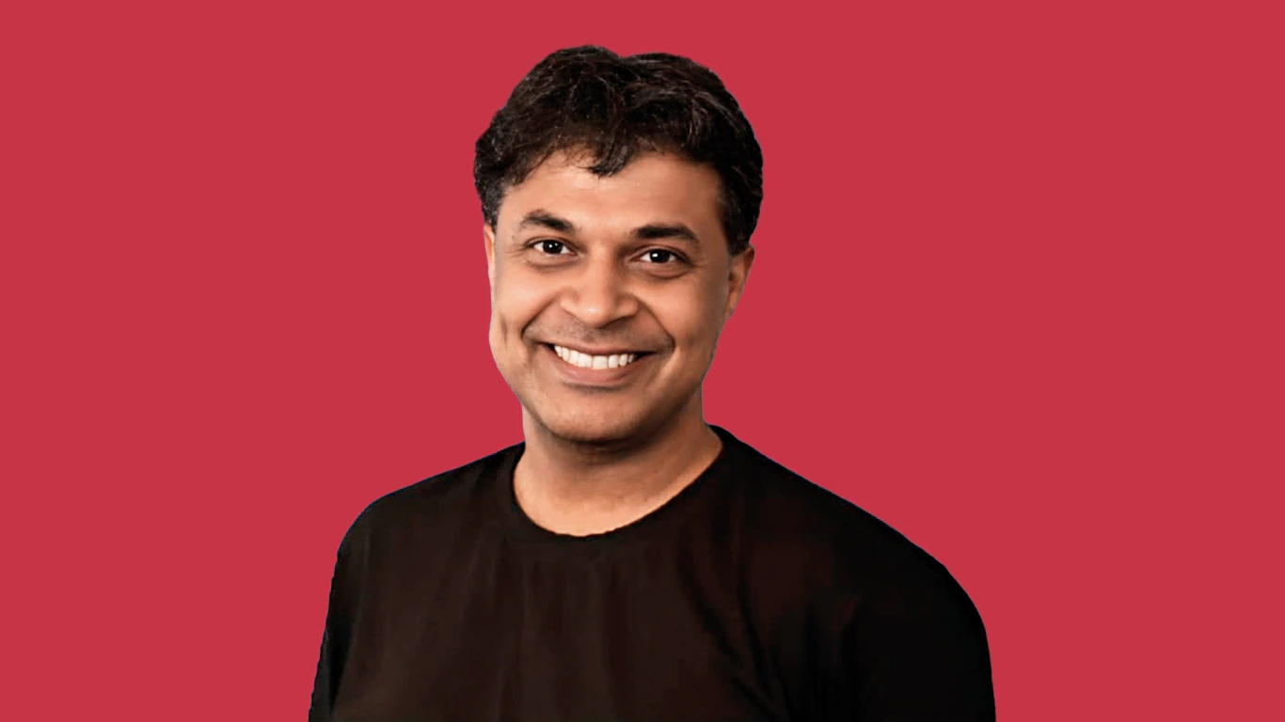
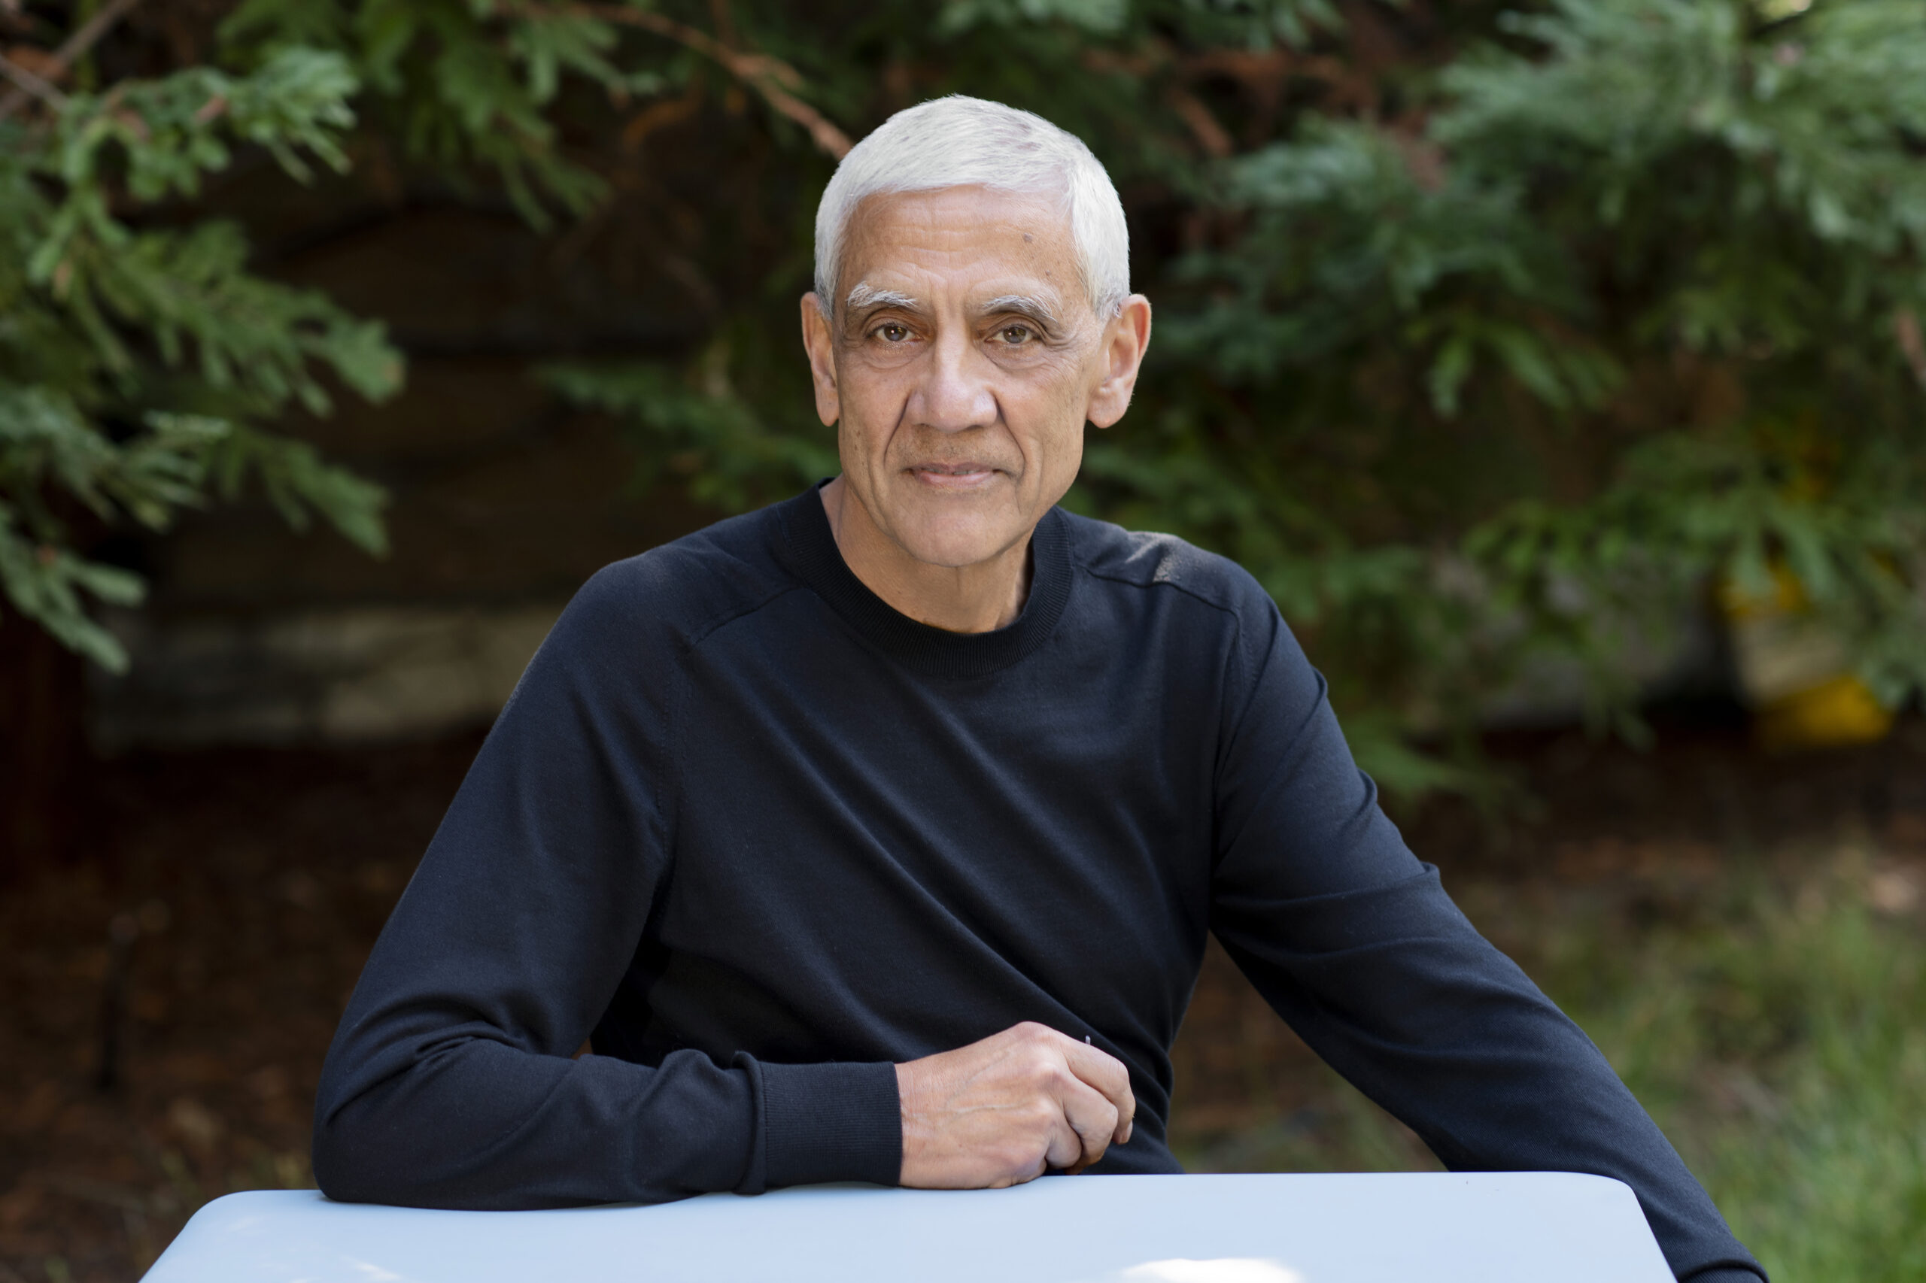
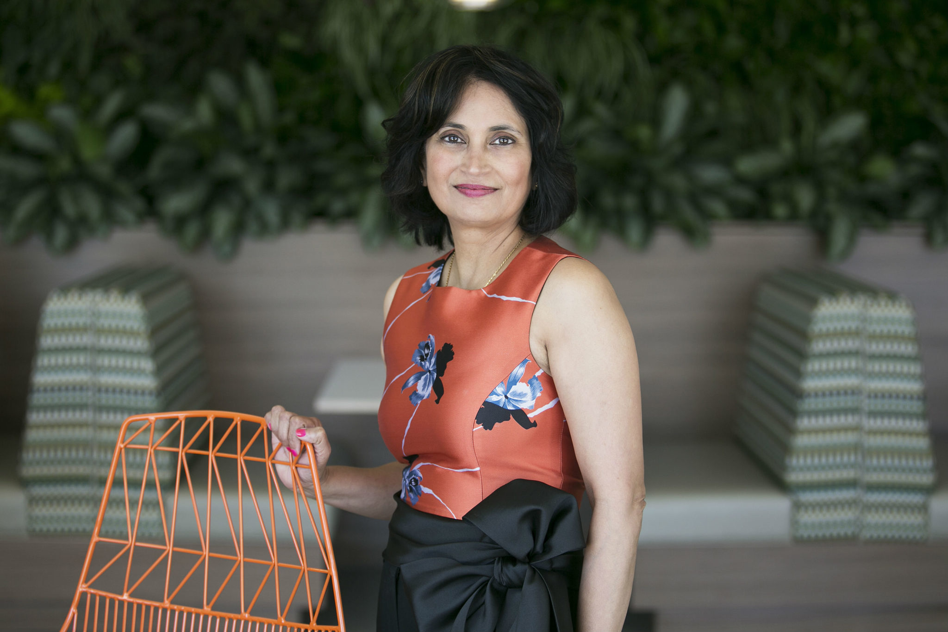
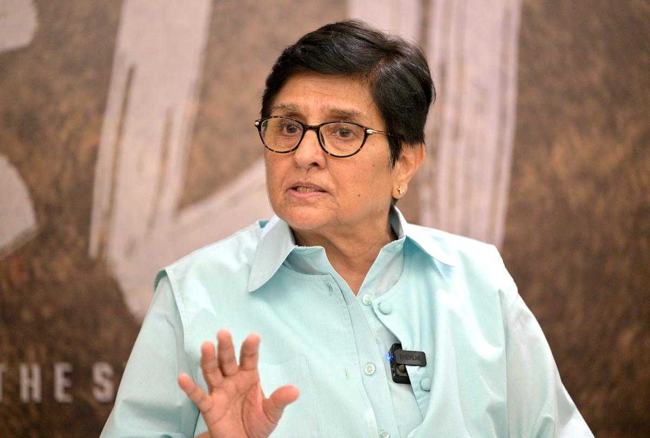
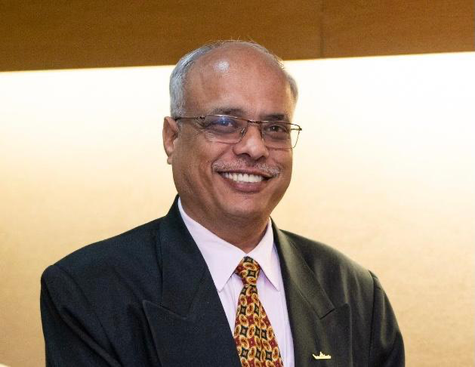
Alumni with Remarkable Achievements
Deepinder Goyal (Founder - Eternal)
Binny Bansal
(Founder - Flipkart)
Sachin Bansal
(Founder – Flipkart)
Raghuram Rajan
(Ex Governor RBI)
Sanjay Sudhir
(Retd Ambassador to UAE)
Vivek Ragh
(Sarvam AI)
Vinod Khosla
(Co-Founder - Sun Microsystems)
Padamsree Warrior
(Founder - Fable)
Dr. Kiran Bedi
(IPS (Retd) and former Lieutenant Governor, Puducherry)
Rear Admiral GK Harish
(AVSM, VSM - Retd.)

Slide 10
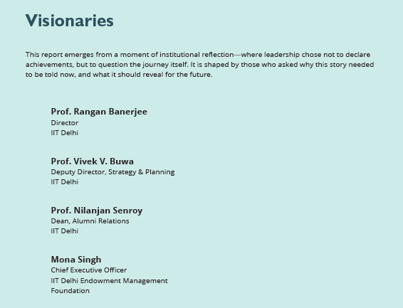
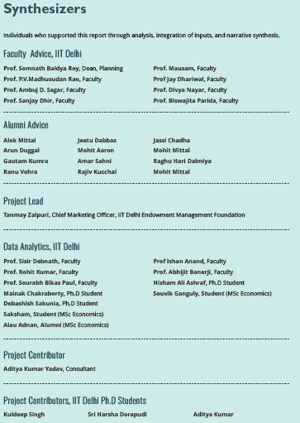
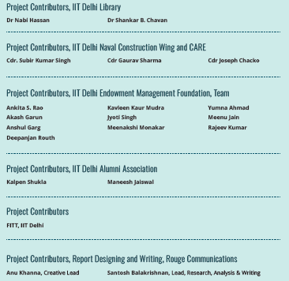

Slide 11
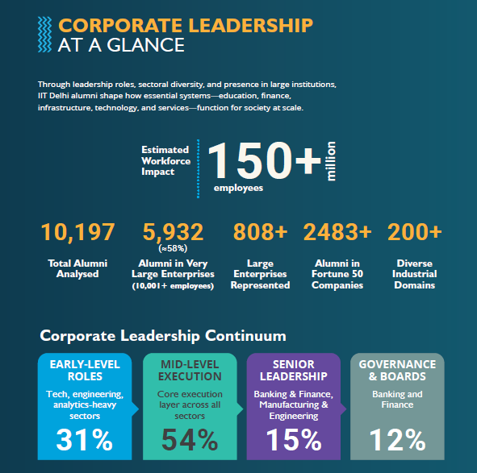
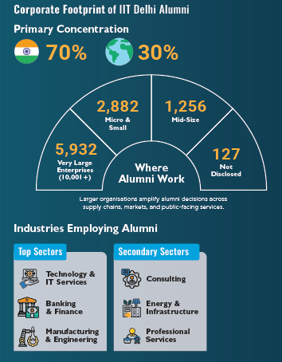

Slide 12
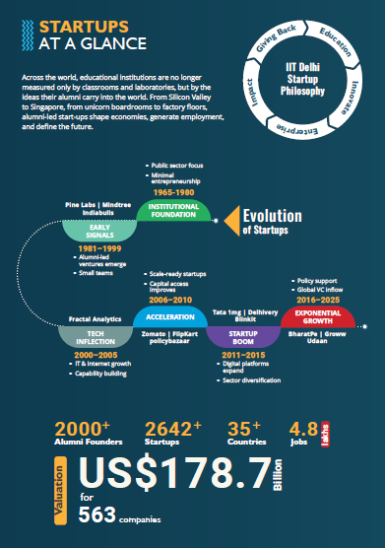
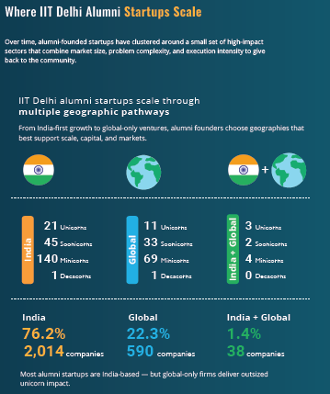

Slide 13
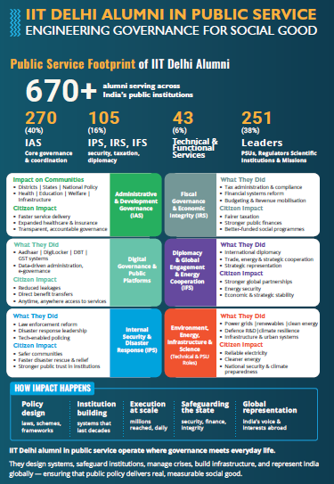
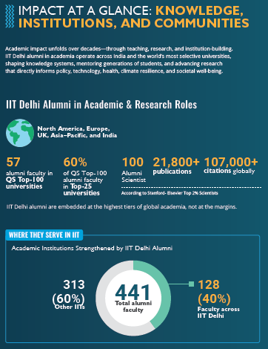

Slide 14

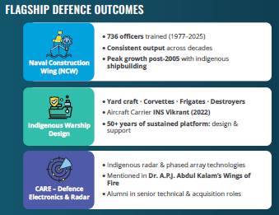

Slide 15

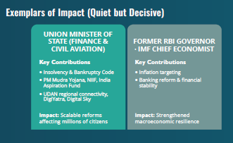

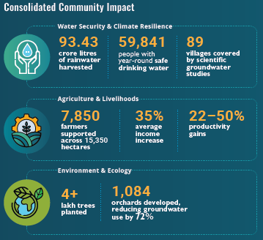

Slide 16
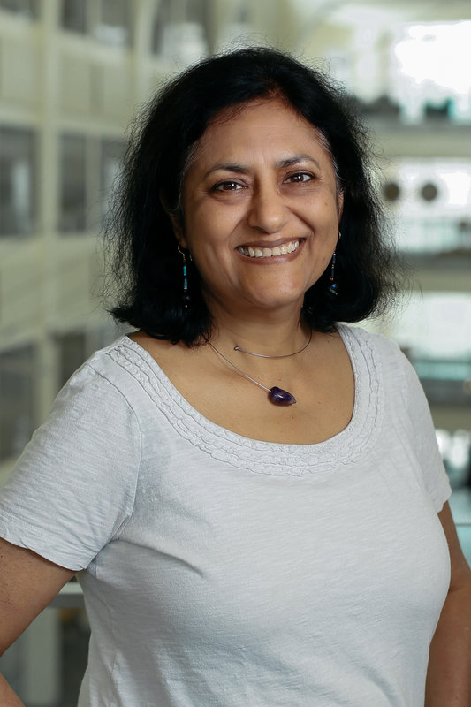
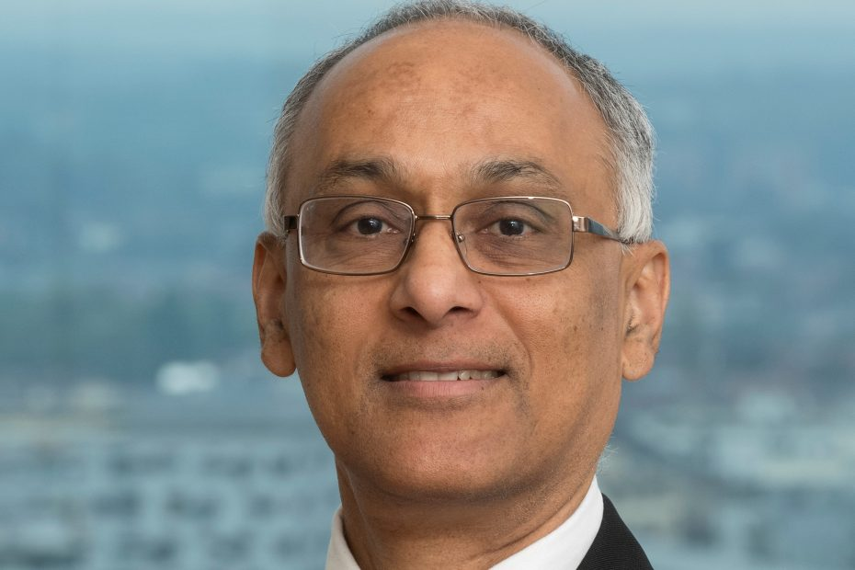
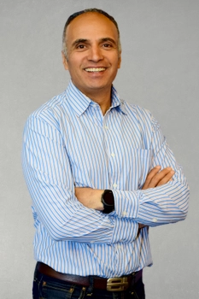
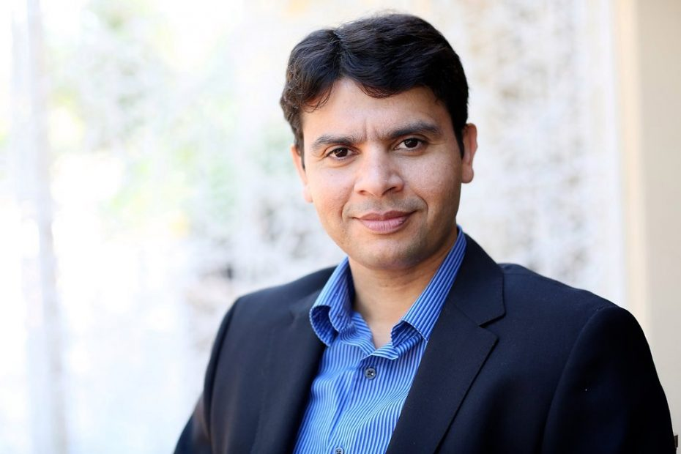
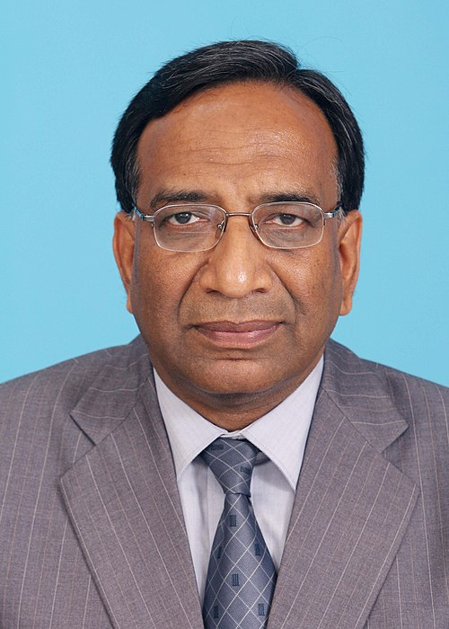
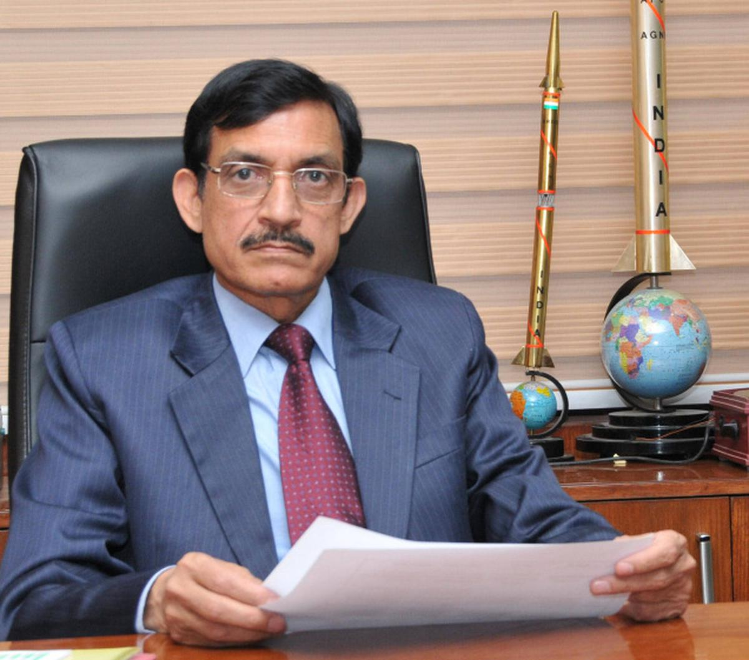
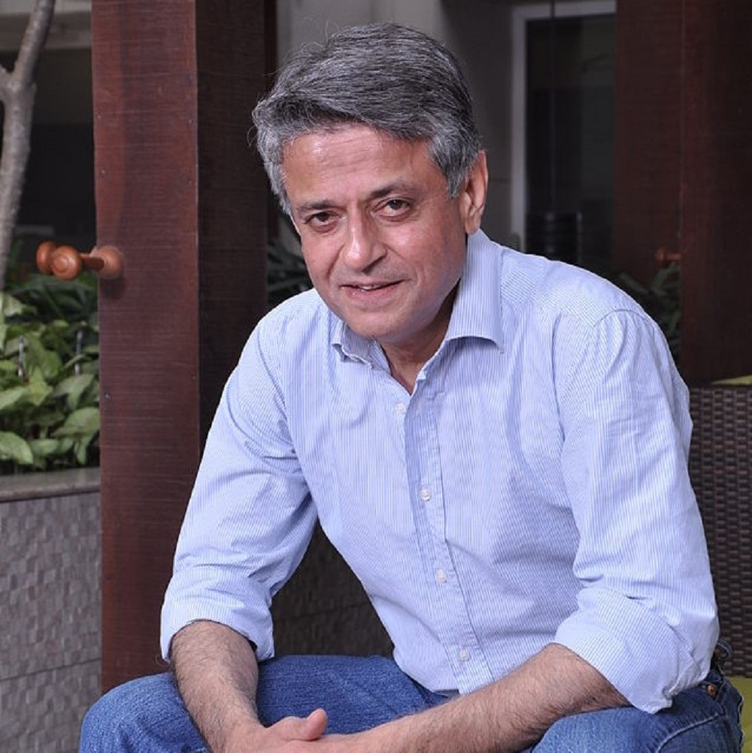
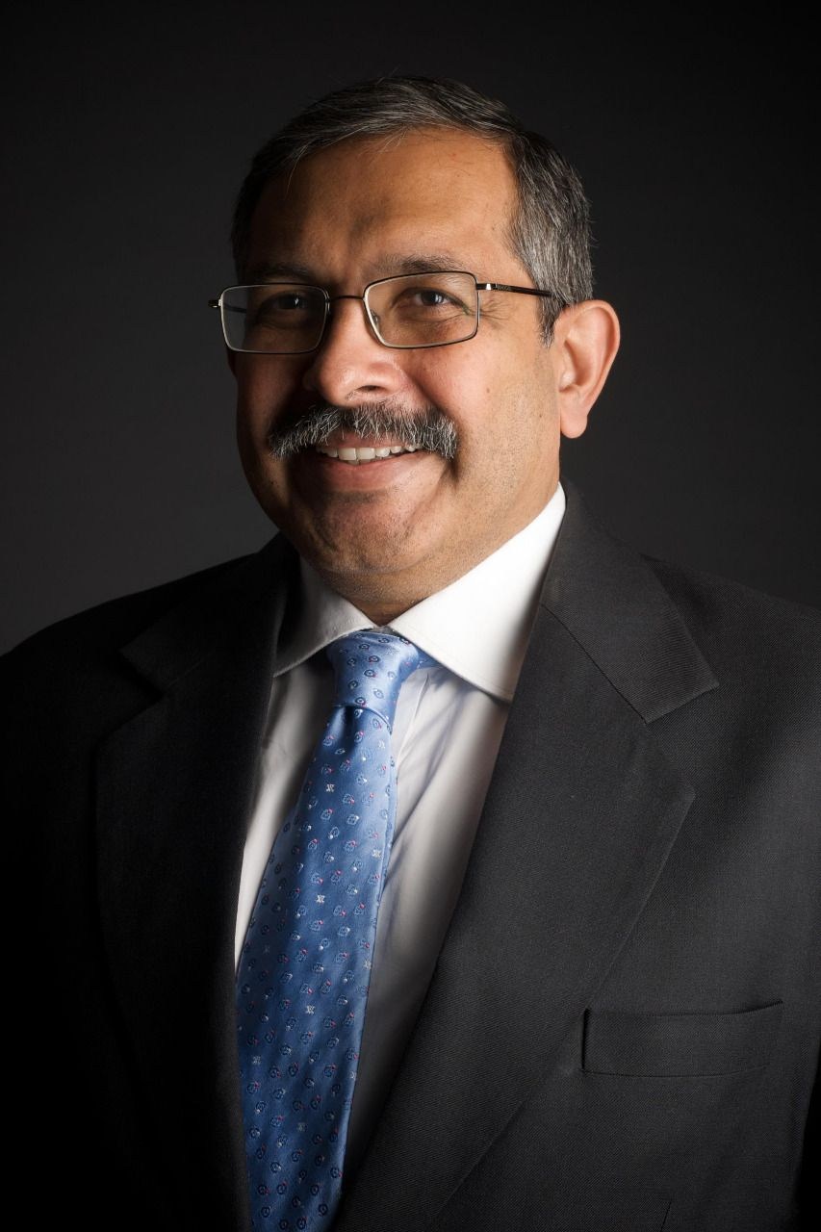
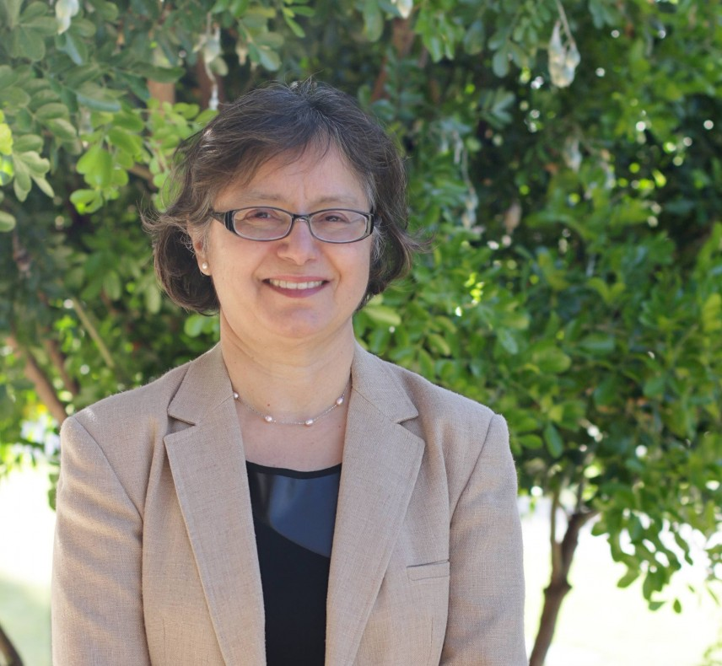
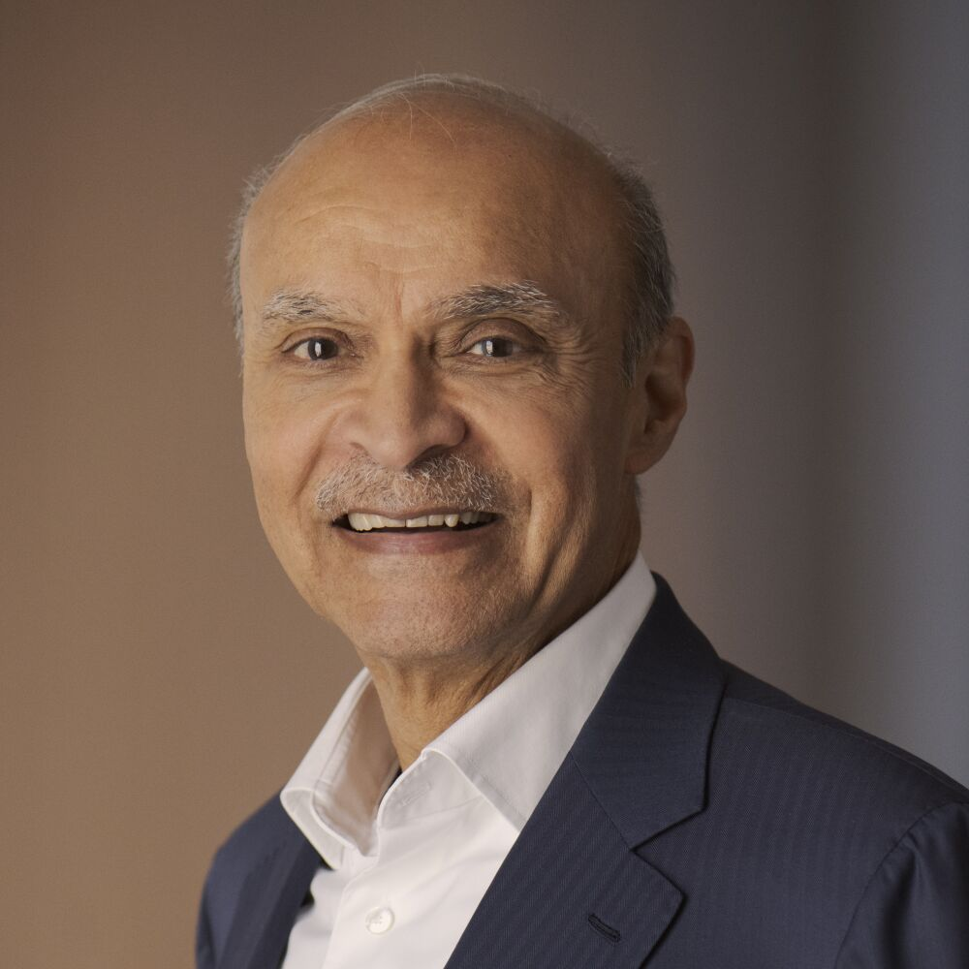
Alumni with Remarkable Achievements
Prof Nandini Trivedi
(Professor, Ohio State University)
Dr. Satish Singh
(V.P. Moderna Therapeutics)
Yashish Dahiya
(Co-Founder, Policy bazaar)
Mohit Aron
(Founder Nutanix & Cohesity)
Pradeep Kumar
(Retd. CVC)
Dr. Avinash Chander
(Padma Shri; DRDO)
Patanjali Keswani
(CMD, Lemon Tree Hotels)
Prof. Devang Khakhar
(Retd. Director, IIT Bombay)
Prof. Renu Malhotra
(Professor, University of Arizona)
Manvinder Singh Banga
(Former President, Unilever)

Slide 17






Alumni with Remarkable Achievements
Vijay Kumar Thadani
(Co-founder, NIIT)
Dr. Vijay Pandurang Bhatkar
(Padma Shri, Padma Bhushan, PARAM Supercomputer)
Rajendra Singh Pawar
(Chairman and Co-founder, NIIT Limited)
Y.C. Deveshwar
(Former Chairman, ITC Limited)
Prof Arogyaswami Paulraj
(Professor Emeritus, Stanford University)
Dr. Gurtej Singh Sandhu
(VP, Micron Technology)

Slide 18

1
IIT Delhi has been undergoing a fundamental transformation evolving from a premier undergraduate teaching to a comprehensive, research-driven knowledge generating institute
The Transformation Continues
2
Today, the Institute educates far more students than in earlier decades, and those students now come from a much wider range of economic, social, and geographical backgrounds.
3
New campuses in Abu Dhabi and Sonipat extend IIT Delhi’s reach beyond its Hauz Khas roots
4
In 2025, IIT Delhi introduced a revised undergraduate curriculum designed around three core principles: greater flexibility, deeper hands-on learning, and alignment with the needs of the modern world.
5
Introduction of Professors of Practice (PoP) from 2022 onwards.
6
IIT Delhi Endowment Fund - built entirely through alumni contributions—provides the Institute strategic flexibility to invest in new ideas, expand academic programmes, and sustain excellence without being constrained by short-term funding cycles

Slide 19





IIT Delhi Endowment Fund Update
Funds Raised And Utilisation
477
CR
Pledged
75+
Chairs
115+
Awards
137+
Scholarships
Hospital
Equipment
Merit Scholarships
145 CR
Mittal Sports Complex
Yardi School of AI
CERCA
193 CR
338
CR
Realised
Mobility &
Mental
Wellness
International
Travel Grants
& Flood Relief
Source: IIT Delhi, IIT Delhi Endowment Management Foundation

Slide 20


Culture of Giving Back
The IIT Delhi Class of 2000 pledges INR 70+ Crore at their Silver Jubilee Reunion in 2025
IIT Delhi launched the Deepak Raghavan Family Foundation Accelerator Programme to strengthen young faculty in research (Jan 2026)

Slide 21


